Slide 1
Ch.2 Parameter Extraction in
Time-Domain Spectrometers
Lee Jong Geon

Slide 2
Contents
Material Properites and Wave Propagation
Extracting Optical Parameters fromTerahertz Time-Domain Spectromerters Data
Preprocessing and Postprocessing of Data
Sample Requirements

Slide 3
Material Properties and
Wave Propagation

Slide 4



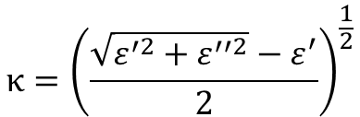
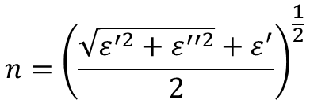

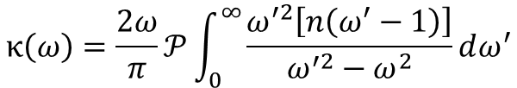
1.1 Complex Refeactive Index and Complex Permitivity
Complex Refractive Index
$$n={\left(\frac{\sqrt{ε^{′2}+ε^{′′2}}+ε^{′}}{2}\right)}^{\frac{1}{2}}$$
$$\overline{n}=n^{′} −jκ$$
$$\overline{ε}= {\overline{n}}^{2}$$
Complex Permittivity Index
$$κ={\left(\frac{\sqrt{ε^{′2}+ε^{′′2}}−ε^{′}}{2}\right)}^{\frac{1}{2}}$$
$$\overline{ε}=ε^{′} −jε^{′′}$$
Kramers-Kronig relations
$$n\left(ω\right)=1+\frac{2ω}{π}𝒫\int_{0}^{∞}{\frac{κ\left(ω^{′}\right)}{ω^{′2}−ω^{2}}dω^{′}}$$
$$κ\left(ω\right)=\frac{2ω}{π}𝒫\int_{0}^{∞}{\frac{ω^{′2}\left[n\left(ω^{′}−1\right)\right]}{ω^{′2}−ω^{2}}dω^{′}}$$

Slide 5
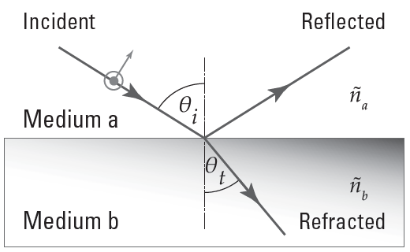






1.2 Plane Wave Propagation Across an Interface – Fresnel Equations
$$t_{TE}=\frac{2{\overline{n}}_{a}\cos{θ_{i}}}{{\overline{n}}_{a}\cos{θ_{i}}+{\overline{n}}_{b}\cos{θ_{t}}}$$
$$t_{TM}=\frac{2{\overline{n}}_{a}\cos{θ_{i}}}{{\overline{n}}_{a}\cos{θ_{t}}+{\overline{n}}_{b}\cos{θ_{i}}}$$
$$r_{TE}=\frac{{\overline{n}}_{a}\cos{θ_{i}} −{\overline{n}}_{b}\cos{θ_{t}}}{{\overline{n}}_{a}\cos{θ_{i}}+{\overline{n}}_{b}\cos{θ_{t}}}$$
$$r_{TM}=\frac{{\overline{n}}_{a}\cos{θ_{t}} −{\overline{n}}_{b}\cos{θ_{i}}}{{\overline{n}}_{a}\cos{θ_{t}}+{\overline{n}}_{b}\cos{θ_{i}}}$$
$$r_{b→a}=−r_{a→b}$$
$$t_{a→b}t_{b→a}=1−r_{a→b}^{2}$$

Slide 6
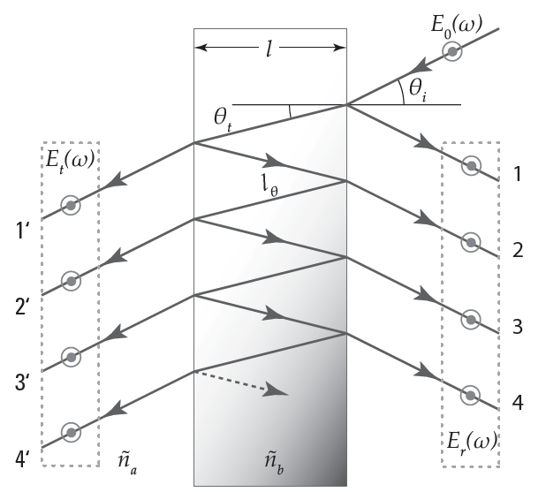
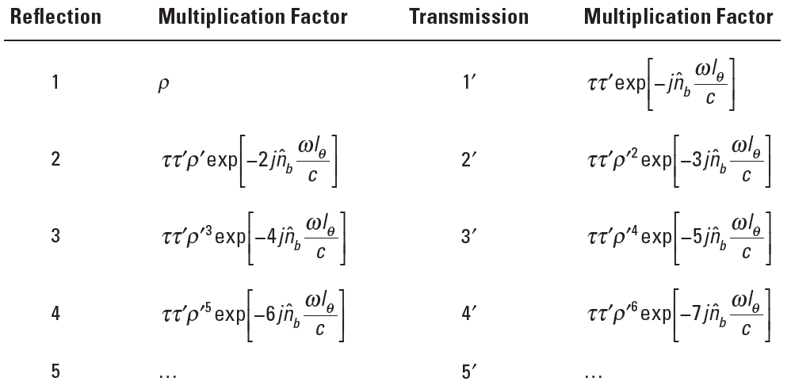
1.3 Plane Wave Propagation Through a Dielectric Slab

Slide 7
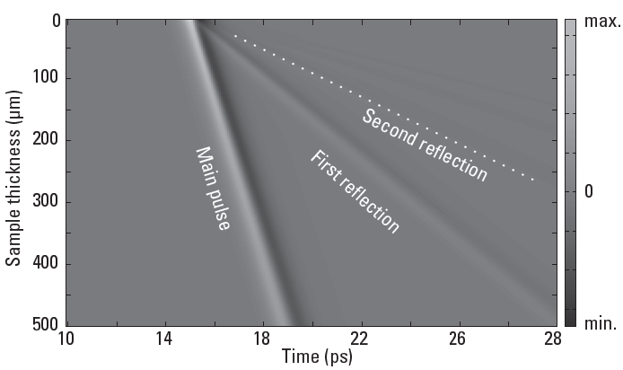
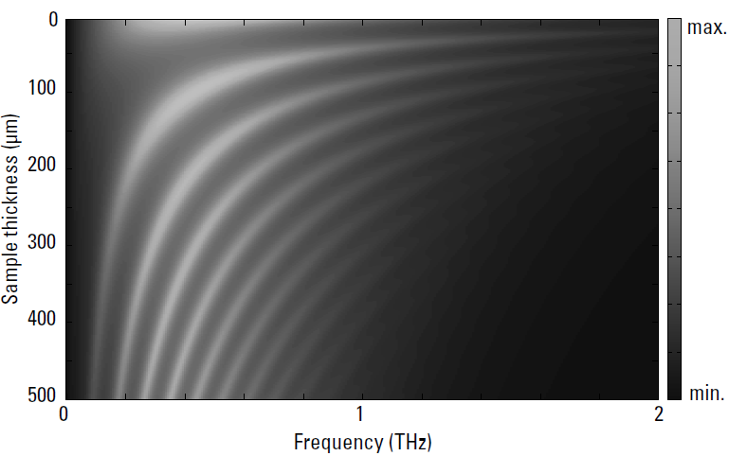


1.4 Fabry-Pérot Effect
$$∆t=\frac{2n_{g}l}{c}$$
$$∆f=\frac{c}{2n_{g}l}$$

Slide 8
Extracting Optical Parameters from
Terahertz TDS Data

Slide 9

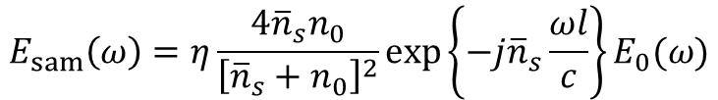
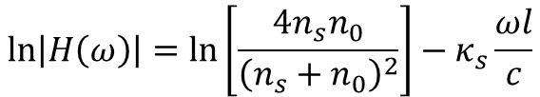

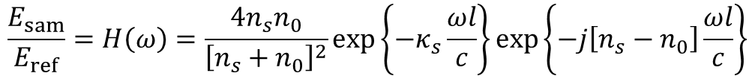
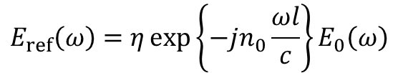
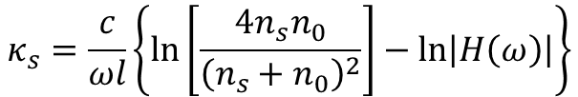
2.1 Transmission-Mode Terahertz TDS: Approximation
Dielectric slab at normal incidence
$$E_{sam}\left(ω\right)=η\frac{4{\overline{n}}_{s}n_{0}}{{\left[{\overline{n}}_{s}+n_{0}\right]}^{2}}\exp\left\{−j{\overline{n}}_{s}\frac{ωl}{c}\right\}E_{0}(ω)$$
$$E_{ref}\left(ω\right)=η\exp\left\{−jn_{0}\frac{ωl}{c}\right\}E_{0}\left(ω\right)$$
$$\frac{E_{sam}}{E_{ref}}=H\left(ω\right)=\frac{4n_{s}n_{0}}{{\left[n_{s}+n_{0}\right]}^{2}}\exp\left\{−κ_{s}\frac{ωl}{c}\right\}\exp\left\{−j\left[n_{s}−n_{0}\right]\frac{ωl}{c}\right\}$$
$$∠H\left(ω\right)=−\left[n_{s}−n_{0}\right]\frac{ωl}{c}$$
$$\ln\left|H\left(ω\right)\right|=\ln\left[\frac{4n_{s}n_{0}}{{\left(n_{s}+n_{0}\right)}^{2}}\right]−κ_{s}\frac{ωl}{c}$$
$$n_{s}=n_{0}−\frac{c}{ωl}∠H\left(ω\right)$$
$$κ_{s}=\frac{c}{ωl}\left\{\ln\left[\frac{4n_{s}n_{0}}{{\left(n_{s}+n_{0}\right)}^{2}}\right]−\ln\left|H\left(ω\right)\right|\right\}$$

Slide 10
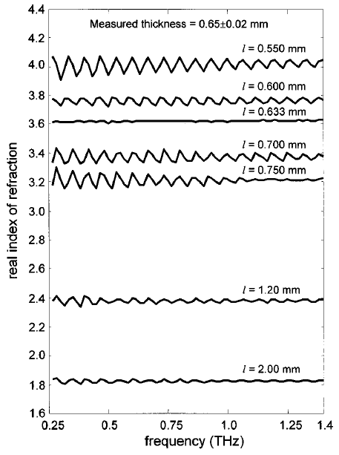
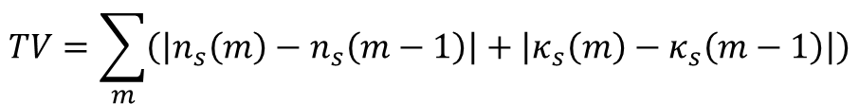
2.2 Transmission-Mode Terahertz TDS: Exact Solution
It is based on minimizing error in the magnitude and phase components of the modeled transfer function with respect th the measured transfer function
Gradient-Descent Algorithm
Step 1: Estimate a range of possible thickness
Step 2: Initialize the complex refractive index
Step 3: Determine the modeled transfer function
Step 4: Estimate the error
Step 5: Update the complex refractive index
Step 6: Determine the total variation
➔ The ultimate complex refractive index from Step 5 would contain ripple if the thickness selected
$$TV=\sum_{m}{\left(\left|n_{s}\left(m\right)−n_{s}\left(m−1\right)\right|+\left|κ_{s}\left(m\right)−κ_{s}\left(m−1\right)\right|\right)}$$
Dorney, T., R. Baraniuk, and D. Mittleman, “Material Parameter Estimation with Terahertz Time-Domain Spectroscopy,” Journal of the Optical Society of America A: Optics, Image Science, and Vision, Vol. 18, No. 7, 2001.

Slide 11
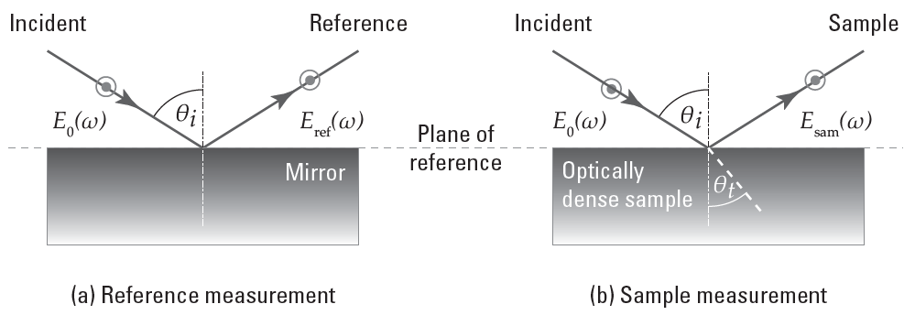
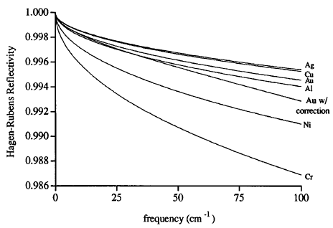





2.3 Reflection-Mode Terahertz TDS: Single Reflection
Single reflection → Two scan (reference, sample)
Double reflection → One scan (combined)
$$E_{ref}\left(ω\right)=−E_{0}(ω)$$
$$E_{sam}\left(ω\right)=rE_{0}\left(ω\right)$$
$$H\left(ω\right)=A\exp\left(jφ\right)=\frac{E_{sam}\left(ω\right)}{E_{ref}\left(ω\right)}=−r=\frac{n_{s}\cos{θ_{t}}−\cos{θ_{i}}}{n_{s}\cos{θ_{t}}−\cos{θ_{i}}}$$
$$n_{s}\left(ω\right)=\frac{1−A^{2}}{1+A^{2}−2A\cos{φ}}$$
$$κ_{s}\left(ω\right)=\frac{−2A\sin{φ}}{1+A^{2}−2A\cos{φ}}$$
Mirror and sample positioning become cruical
Gatesman, A. J., R. H. Giles, and J. Waldman, “High-Precision Reflectometer for Submillimeter wavelength,” Journal of the Optical Society of America B: Optical Physics, Vol. 12, No. 2, 1995.

Slide 12
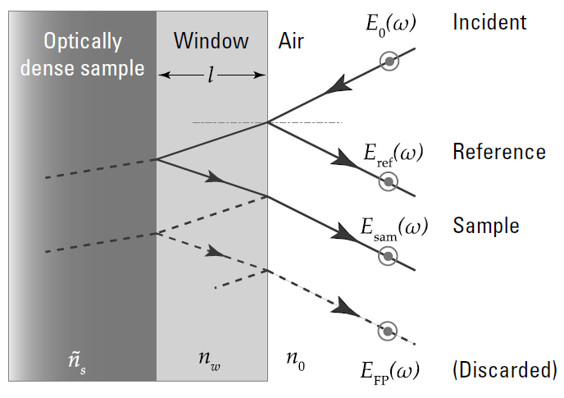
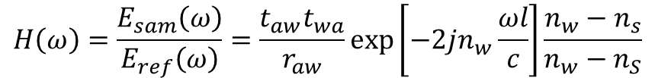



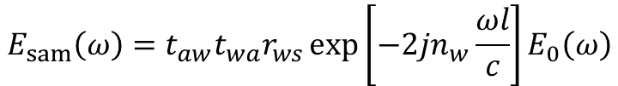
2.4 Reflection-Mode Terahertz TDS: Double Reflection
$$E_{ref}\left(ω\right)=r_{aw}E_{0}(ω)$$
$$E_{sam}\left(ω\right)=t_{aw}t_{wa}r_{ws}\exp\left[−2jn_{w}\frac{ωl}{c}\right]E_{0}\left(ω\right)$$
$$H\left(ω\right)=\frac{E_{sam}\left(ω\right)}{E_{ref}\left(ω\right)}=\frac{t_{aw}t_{wa}}{r_{aw}}\exp\left[−2jn_{w}\frac{ωl}{c}\right]\frac{n_{w}−n_{s}}{n_{w}−n_{S}}$$
$$n_{s}\left(ω\right)=\frac{n_{w}\left(1−A^{2}\right)}{1+A^{2}−2A\cos{φ}}$$
$$κ_{s}\left(ω\right)=\frac{−2n_{w}A\sin{φ}}{1+A^{2}−2A\cos{φ}}$$

Slide 13
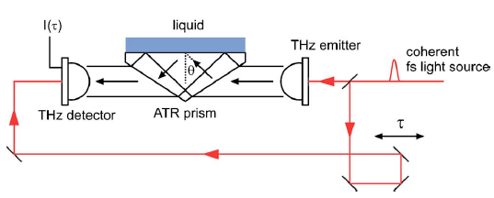

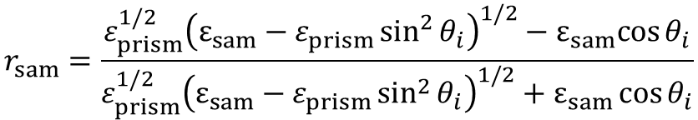
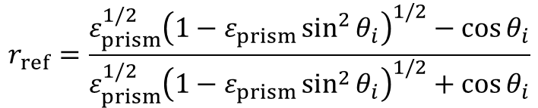
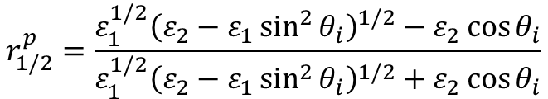
2.5 Attenuated Total Reflection
$$r_{ref}=\frac{ε_{prism}^{1/2}{\left(1−ε_{prism}\sin^{2}{θ_{i}}\right)}^{1/2}−\cos{θ_{i}}}{ε_{prism}^{1/2}{\left(1−ε_{prism}\sin^{2}{θ_{i}}\right)}^{1/2}+\cos{θ_{i}}}$$
$$r_{1/2}^{p}=\frac{ε_{1}^{1/2}{\left(ε_{2}−ε_{1}\sin^{2}{θ_{i}}\right)}^{1/2}−ε_{2}\cos{θ_{i}}}{ε_{1}^{1/2}{\left(ε_{2}−ε_{1}\sin^{2}{θ_{i}}\right)}^{1/2}+ε_{2}\cos{θ_{i}}}$$
$$r_{sam}=\frac{ε_{prism}^{1/2}{\left(ε_{sam}−ε_{prism}\sin^{2}{θ_{i}}\right)}^{1/2}−ε_{sam}cos{θ_{i}}}{ε_{prism}^{1/2}{\left(ε_{sam}−ε_{prism}\sin^{2}{θ_{i}}\right)}^{1/2}+ε_{sam}\cos{θ_{i}}}$$
$$H\left(ω\right)=\frac{r_{sam}}{r_{ref}}$$
Møller, U., et al., “Terahertz Reflection Spectroscopy of Debye Relaxation in Polar Liquids,” JOSA B, Vol. 26, No. 9, 2009.
Nagai, M.m et al, “Terahertz Time-Domain Attenuated Total Reflection Spectroscopy in Water and Biological Solution,” International Journal of Infrared and Millimeter Waves, Vol. 27, No. 4, 2006.

Slide 14
Preprocessing and
Postprocessing of Data

Slide 15
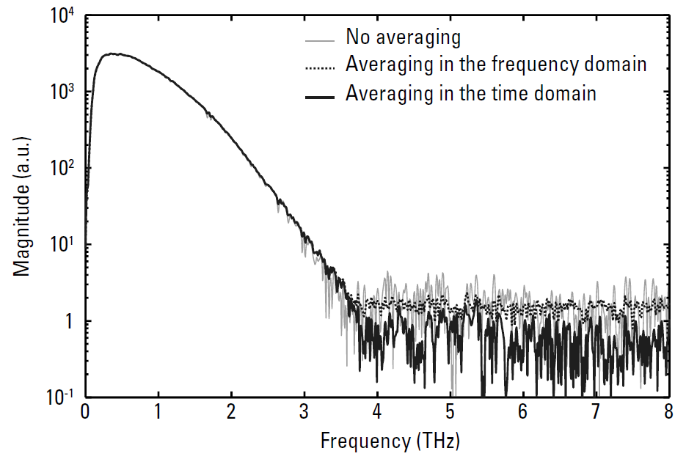
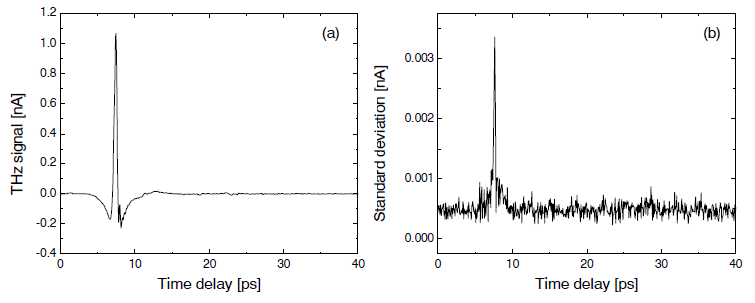
3.1 Signal Averaging in the Time and Frequency Domains
The averaging is effective in the time domain, but not in the frequency domain
Fischer, B. M., M. Hoffmann, and P. U. Jepsen, “Dynamic Range and Numerical Error Propagation in Terahertz Time-Domain Spectroscopy,” in Optical Terahertz Science and Technology, Technical Digest (CD). Optical Society of America, 2005, paper TuD1.

Slide 16
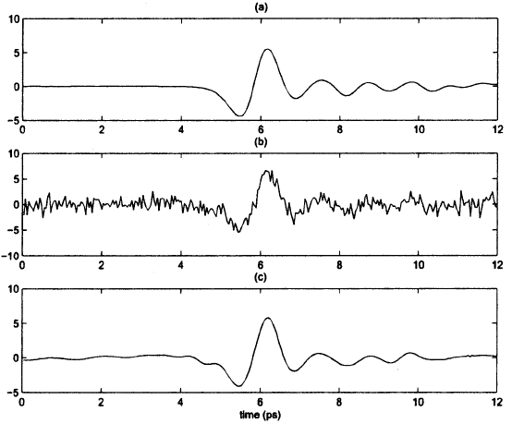
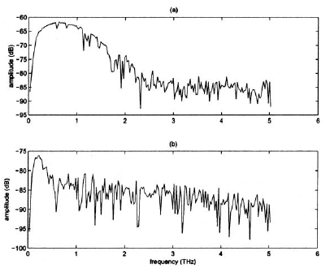
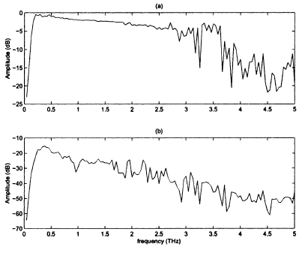
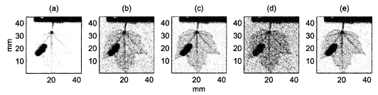
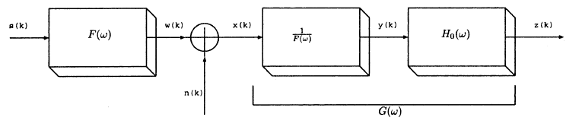
3.2 Signal Denoising
Noise in a terahertz signal could be reduced by digital signal processing techniques in addition to signal averaging.
Leaf original response
Noise added
Fatty
Wavelet de-noising
Meat
Ferguson, B., and D. Abbott, “De-Noising Techniques for Terahertz Responses of Biological Samples,” Microelectronics Journal, Vol. 32, No. 12, 2001.

Slide 17
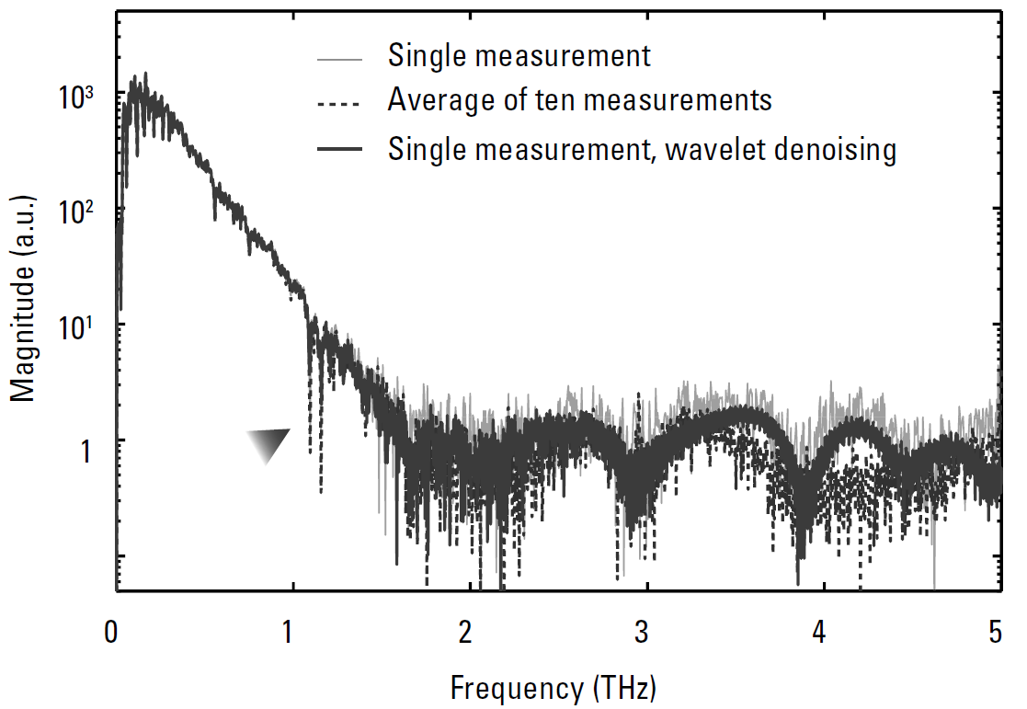
3.2 Signal Denoising
The water vapor absorption peaks near 1THz are reduced in magnitude after denoising

Slide 18
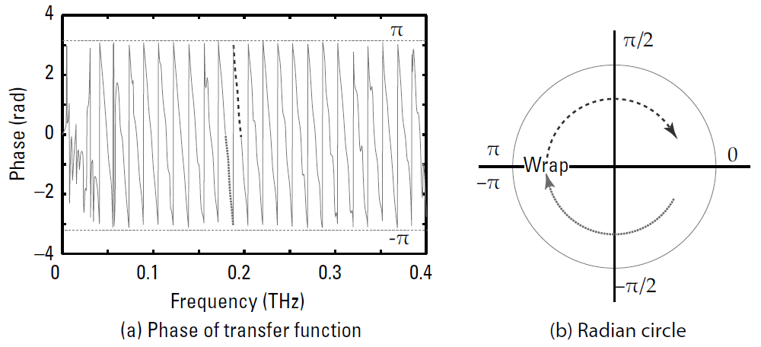
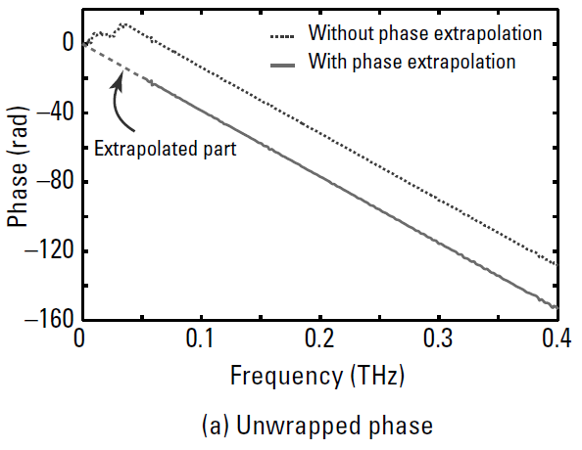
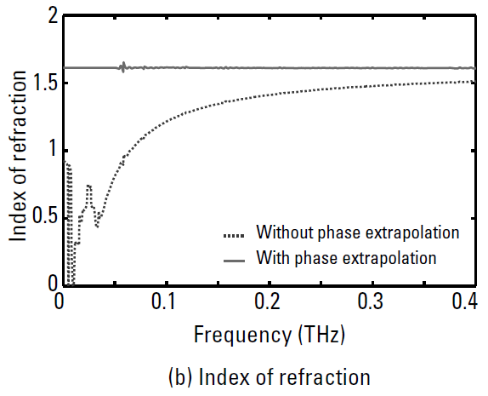
3.3 Phase Unwrapping
In most case the assumption of a linear phase is sufficient. Phase-jumping causes discontinuities in a phase spectrum

Slide 19
Sample Requirements

Slide 20
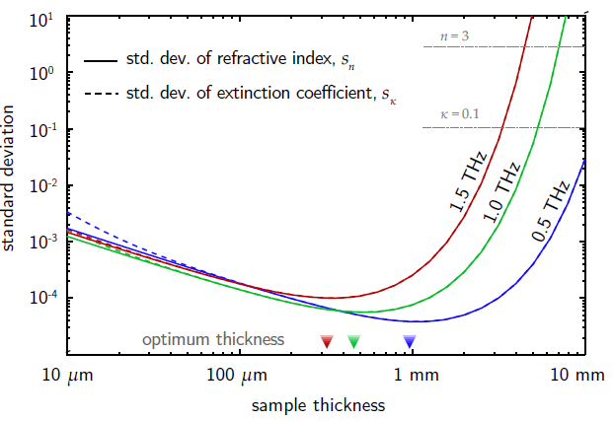

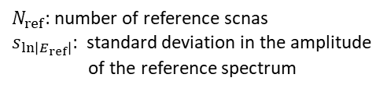

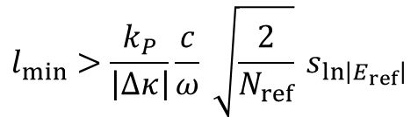
4.1 Sample Thickness
Maximum Thickness
An upper bound of the sample thickness for a given absorption value is determined from the system’s dynamic range.
$$l_{max}=\frac{2}{α}\ln\left[DR\frac{4n}{{\left(n+1\right)}^{2}}\right]$$
Minimum Thickness
The minimal thickness is limited by the standard deviation of the signal
$$l_{min}>\frac{k_{P}}{\left|∆κ\right|}\frac{c}{ω} \sqrt{\frac{2}{N_{ref}}} s_{\ln\left|E_{ref}\right|}$$
$N_{ref}$: number of reference scnas
$s_{\ln\left|E_{ref}\right|}$: standard deviation in the amplitude
of the reference spectrum
Optimal Thickness
The optimal sample thickness is determined solely from the intrinsic material properties, and not from the system characteristics
$$l_{opt}=\frac{c}{ωκ}=\frac{2}{α}$$
Fischer, B. M., M. Hoffmann, and P. U. Jepsen, “Dynamic Range and Numerical Error Propagation in Terahertz Time-Domain Spectroscopy,” in Optical Terahertz Science and Technology, Technical Digest (CD). Optical Society of America, 2005, paper TuD1.
Withayachumnankul, W., et al., “Limitation in Thin-Film Sensing with Tranmissin-Mode Terahertz Time-Domain Spectroscopy,” Optics Express, Vol. 22, No. 1, 2014.

Slide 21
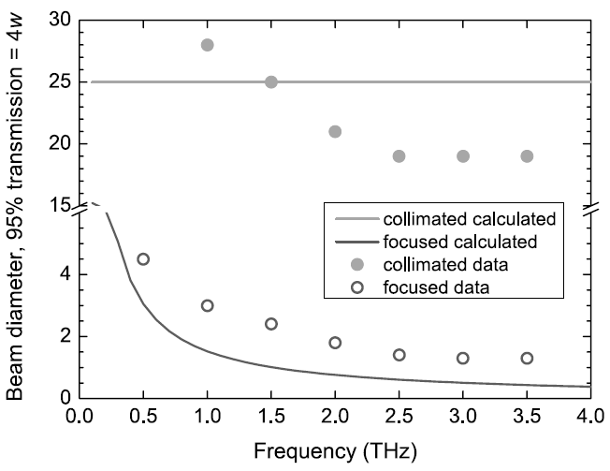
4.2 Lateral Dimensions of Samples
The lateral dimensions of samples should be large enough to a accommodate the terahertz beam without clipping or edge diffraction.
Leaking ➔ Fabry-Perot effect
Diffracted at edge
The sample size must be $>10w$ at the focus and $>2.5w$ in the collimated beam.

Slide 22
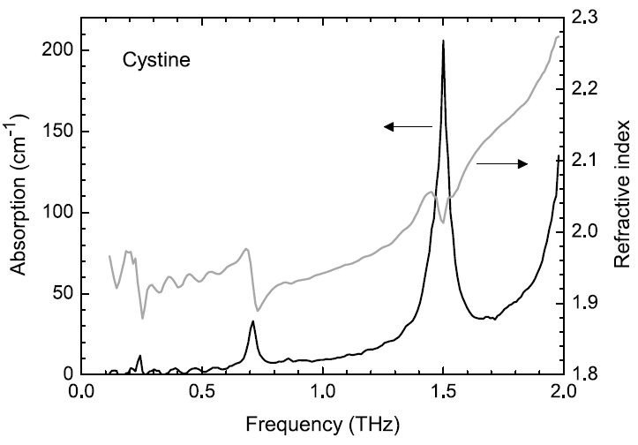
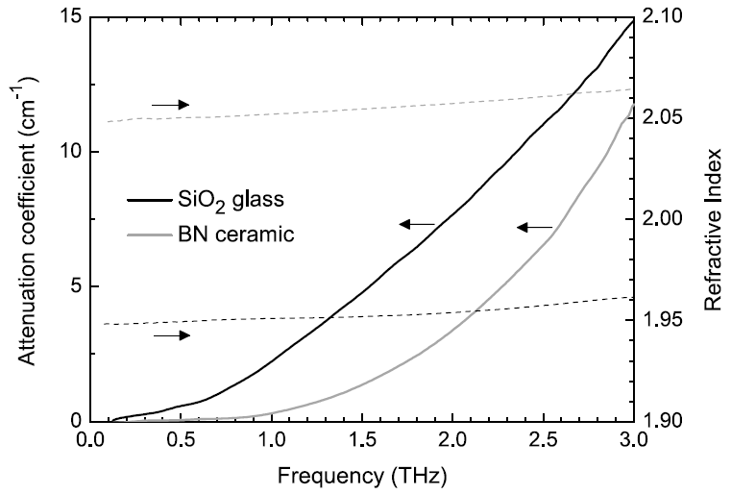


4.3 Loss: Absorption, Scattering, Diffraction
Absorption is an intrinsic property of the material, scattering and diffraction arise from medium-scale material structure.
Kramers-Krönig relationship
Resonant absorption peaks
can be unambiguously identified
The case that non-resonance absorption cannot be reliably differentiated from scattering loss
$$α=Bf^{β}, 2<β<4$$
$$α:The loss coefficient$$
SiO₂ glass: absorption by charge defects
BN ceramic: scattering

Slide 23
References
Dorney, T., R. Baraniuk, and D. Mittleman, “Material Parameter Estimation with Terahertz Time-Domain Spectroscopy,” Journal of the Optical Society of America A: Optics, Image Science, and Vision, Vol. 18, No. 7, 2001, pp. 1562-1571.
Fischer, B. M., M. Hoffmann, and P. U. Jepsen, “Dynamic Range and Numerical Error Propagation in Terahertz Time-Domain Spectroscopy,” in Optical Terahertz Science and Technology, Technical Digest (CD). Optical Society of America, 2005, paper TuD1.
Ferguson, B., and D. Abbott, “De-Noising Techniques for Terahertz Responses of Biological Samples,” Microelectronics Journal, Vol. 32, No. 12, 2001, pp. 943-953.
Gatesman, A. J., R. H. Giles, and J. Waldman, “High-Precision Reflectometer for Submillimeter wavelength,” Journal of the Optical Society of America B: Optical Physics, Vol. 12, No. 2, 1995, pp. 212-219.
Møller, U., et al., “Terahertz Reflection Spectroscopy of Debye Relaxation in Polar Liquids,” JOSA B, Vol. 26, No. 9, 2009, pp. A113-A125.
Nagai, M.m et al, “Terahertz Time-Domain Attenuated Total Reflection Spectroscopy in Water and Biological Solution,” International Journal of Infrared and Millimeter Waves, Vol. 27, No. 4, 2006, pp. 505-515.
Withayachumnankul, W., et al., “Limitation in Thin-Film Sensing with Tranmissin-Mode Terahertz Time-Domain Spectroscopy,” Optics Express, Vol. 22, No. 1, 2014, pp. 972-986.

